Slide 1
Capstone Project:(Week 2): Starting a Restaurant
By Arunkumar.

Slide 2
Introduction
This project's main aim was to determine a suitable area in California to set up a restaurant business. The project starts off with reading the dataset, preprocessing/ cleaning the dataset, using foursquare credentials and finally using geo encoders to plot the map.

Slide 3
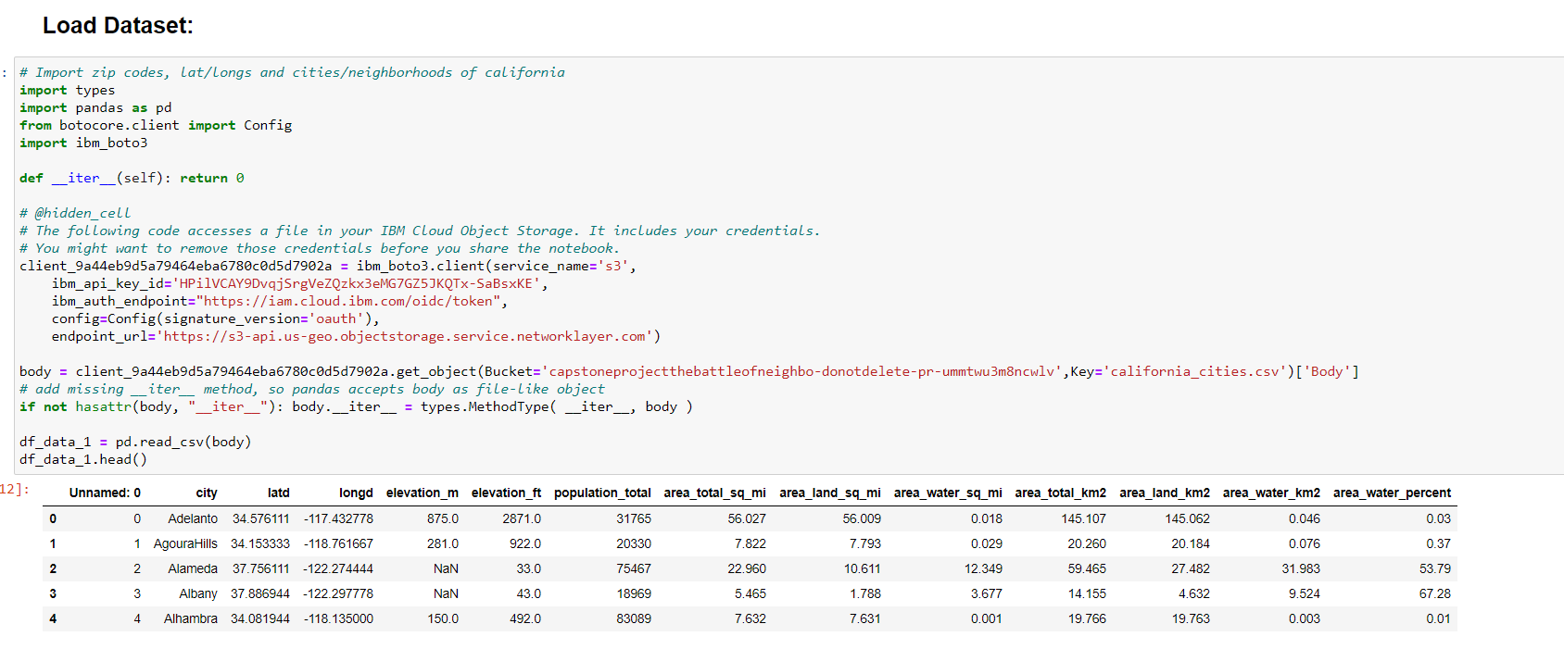
Dataset
The dataset was taken from https://share.cocalc.com/share/e9d2f604-5c15-48c1-8c69-4d560cf9a933/PythonDataScienceHandbook/notebooks/data/california_cities.csv?viewer=share
The dataset can be shown as follows:

Slide 4
Project Description:
The primary focus of this project was to ensure that the area selected in California was suitable for business or not. Hence some key factors were taken into consideration:
Area Population
Longitude
Latitude
The area in sq.m
The project focuses on the struggles dealt with setting up a restaurant. Many factors come into picture when it comes to starting a restaurant and a lot of time goes with investment.

Slide 5
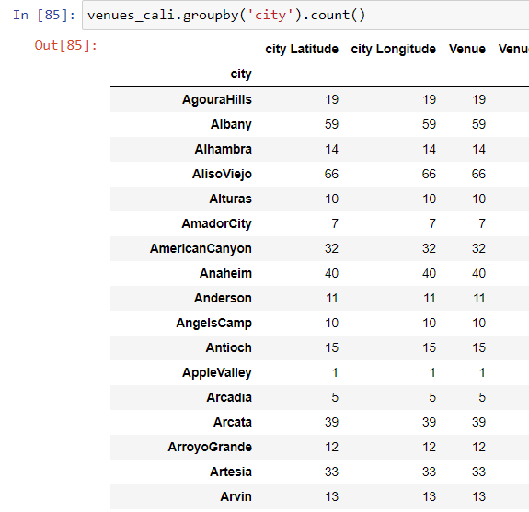
Data Wrangling
The dataset was loaded from the URL mentioned above. Some of the critical aspects done were:
Locate all cities in California
Initially, all the cities are loaded from the dataset and saved in pandas dataframe. The cities are located and shown in the map below:
2. Foursquare credentials
The foursquare credentials are used and the id details can be found in the foursquare developer app that we create.
3. Locate all venues in California
We locate all the venues in California and list down all the restaurants in California The primary forcus is on the cuisine of the restaurants.

Slide 6
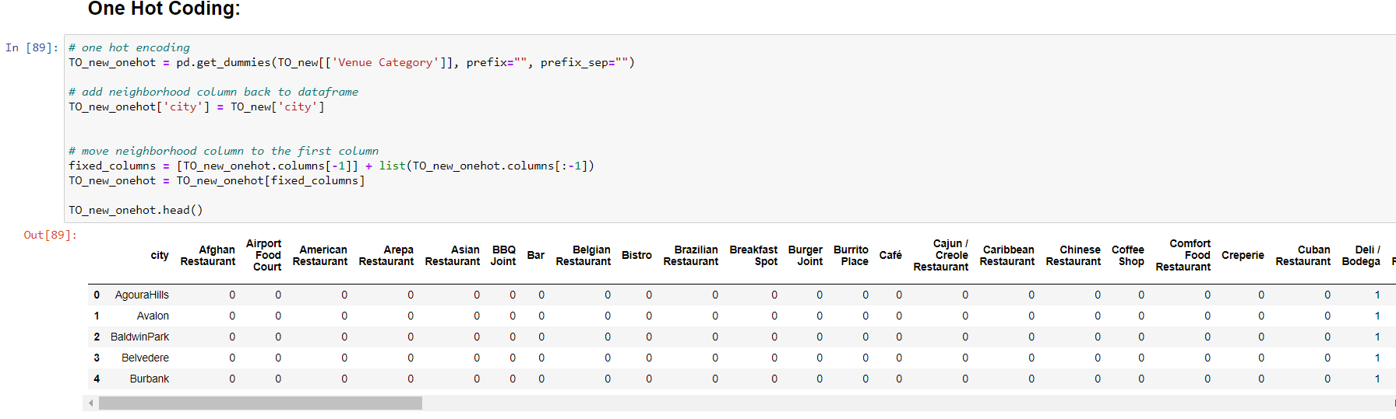
One Hot Coding
For categorical variables where no such ordinal relationship exists, the integer encoding is not enough. In fact, using this encoding and allowing the model to assume a natural ordering between categories may result in poor performance or unexpected results (predictions halfway between categories). In this case, a one-hot encoding can be applied to the integer representation. This is where the integer encoded variable is removed and a new binary variable is added for each unique integer value.

Slide 7

Methodology
The algorithm selected was K means. K means can be defined as follows: “K-means clustering is an iterative clustering algorithm where the number of clusters K is predetermined, and the algorithm iteratively assigns each data point to one of the K clusters based on the feature similarity.” k-means clustering is a method of vector quantization, originally from signal processing, that aims to partition n observations into k clusters in which each observation belongs to the cluster with the nearest mean (cluster centers or cluster centroid), serving as a prototype of the cluster.

Slide 8
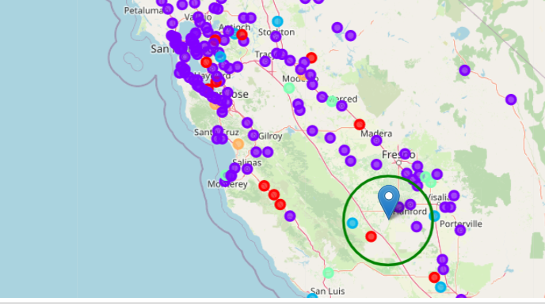
Result
The green circle on the map shows the area where a restaurant can be set up.

Slide 9
Discusion
A lot of critical factors need to be considered while setting up a restaurant. The area and the population in that area is one of them. The preference of people living in the area is also another critical factor to be considered.
A k- means were also used to locate all the nearby points into a cluster. This is the reason why using K means felt like an ideal choice to me.
Locating the map area to set up a restaurant was one of the primary aims, and I was successful.

Slide 10
Conclusion
The area marked on the map is by far the best suitable place to start a restaurant. An improvement I can make to this project is checking the crime rate and other restaurant ratings to check for any competition in the business.

